Slide 1
Logistic Regression

Slide 2
Logistic Regression is a classification algorithm. It is used to predict a binary outcome (1 / 0, Yes / No, True / False) given a set of independent variables
Types of Logistic Regression:
1. Binary Logistic Regression: The categorical response has only two 2 possible outcomes. E.g.: Spam or Not
2. Multinomial Logistic Regression: Three or more categories without ordering. E.g.: Predicting which food is preferred more (Veg, Non-Veg, Vegan)
3. Ordinal Logistic Regression: Three or more categories with ordering. E.g.: Movie rating from 1 to 5

Slide 3
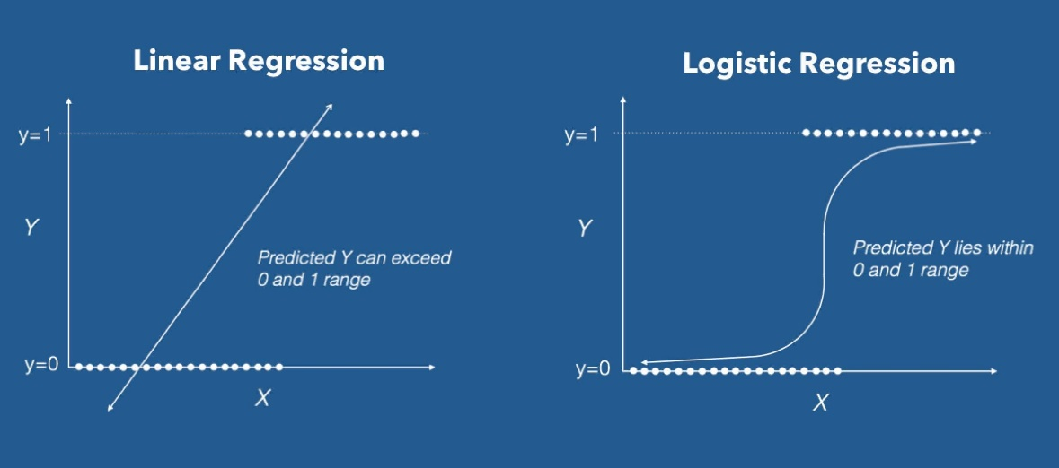
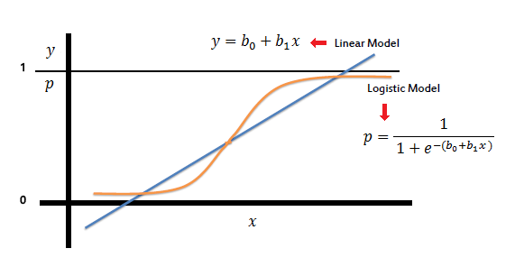

Logistic Regression is used when the dependent variable (target) is categorical.
For example,
To predict whether an email is spam (1) or (0)
Whether the tumor is malignant (1) or not (0)
In the logistic regression the constant (b0) moves the curve left and right and the slope (b1) defines the steepness of the curve. Logistic regression can handle any number of numerical and/or categorical variables.

Slide 4
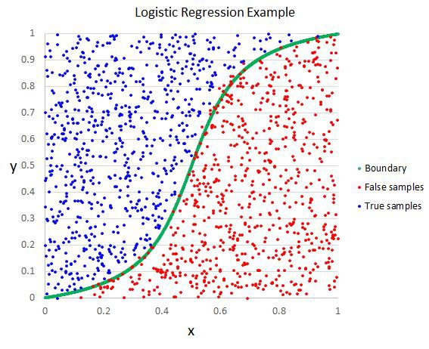
In practice we can use the probabilities directly. Because this is classification and we want a crisp answer, we can snap the probabilities to a binary class value, for example:
0 if p(male) < 0.5
1 if p(male) >= 0.5
Applications of Logistic Regression:
Logistic regression is used in various fields, including machine learning, most medical fields, and social sciences

Slide 5
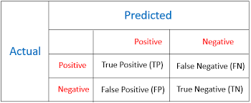
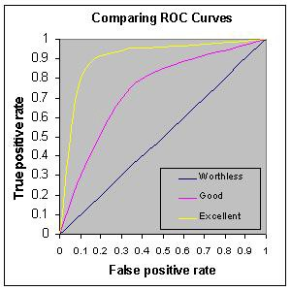
Performance of Logistic Regression Model (Performance Metrics):
AIC (Akaike Information Criteria) - It should be minimum always
Null Deviance and Residual Deviance - Lower the value better the model
Confusion Matrix: It is nothing but a tabular representation of Actual vs Predicted values.
ROC Curve: Receiver Operating Characteristic (ROC) summarizes the model’s performance by evaluating the trade-offs between true positive rate (sensitivity) and false positive rate (1- specificity).

